Slide 1

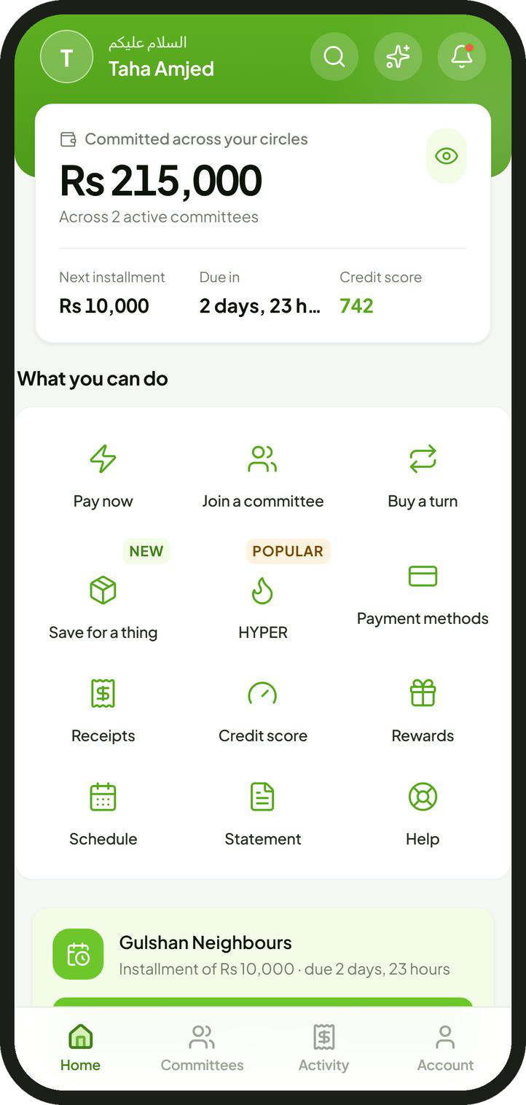
Raqami Islamic Digital Bank
Committee savings, held and moved by an Islamic bank
A partnership proposal for Raqami Islamic Digital Bank
Taha Amjed, Chairman, Halqa
October 2026
Notes:
Halqa runs committees, the rotating savings groups most Pakistani families already use. A committee carries no interest by design. This proposal asks Raqami to hold and move every rupee, while Halqa runs the committee itself.

Slide 2
Summary
Halqa proposes to run Pakistan's committees on Raqami accounts.
The habit
More than a third of Pakistanis save in committees: no interest, all cash, outside any bank.
The proposal
Every member banks with Raqami. Raqami holds and moves every rupee; Halqa runs the committee.
For Raqami
Accounts opened 6 to 20 at a time, deposits, a product without interest and a repayment record to finance against.
For members
No organiser holding cash, automatic payment, takaful against default and a credit record.
The request
Seven decisions, including a Shariah Board ruling, then one live month with about 1,000 members.
2
Notes:
Five points carry the proposal. The habit exists, carries no interest and moves in cash. Every member banks with Raqami and Raqami moves all the money; Halqa provides the rules and the technology. Raqami gains accounts, deposits and a financing record; members gain safety and a credit history. The request is seven decisions, including a Shariah Board ruling, and a one month pilot.

Slide 3
How a Committee Works
Everyone pays the same amount each month. Each month, one member takes the whole pot.
Month
Rs 10,000
1
2
3
4
5
6
7
8
9
10
11
12
1
2
paid in by every member, every month
3
Rs 120,000
4
5
the pot, taken by one member each month
6
Member
7
8
First turn. An advance without interest, repaid by the instalments that follow.
Last turn. Saving, with a deadline the group enforces.
9
10
11
In total, every member pays in Rs 120,000 and takes out Rs 120,000: an interest free loan between members.
12
collects the pot
pays Rs 10,000
Also called a kameti or BC; worldwide, a rotating savings and credit association. Example: twelve members at Rs 10,000 a month.
3
Notes:
Twelve members each pay Rs 10,000 a month. Each month one of them takes the pot of Rs 120,000. Every member pays in exactly what they take out, so each instalment is an interest free loan between members, repaid by the instalments that follow.

Slide 4
The Market
More than a third of Pakistanis save in committees. Almost none of that money reaches a bank.
Where Pakistani savers keep their savings, per cent of savers [2]
34% to 41%
Cash kept at home
63%
of Pakistanis take part in committees [1]
Rs 4 trillion
A committee
33%
estimated to pass through committees each year [1]
A bank or other formal institution
4%
Twice
the rate of participation for women as for men [2]
Sources 1 Karandaaz and Oraan, reported by Dawn, 12 December 2022 2 Financial Inclusion Insights surveys of Pakistan
4
Notes:
Participation estimates range from 34 per cent (Karandaaz) to 41 per cent (Oraan) of Pakistanis, with about Rs 4 trillion estimated to rotate each year. Among savers, 63 per cent keep cash at home, 33 per cent use a committee and only 4 per cent use a bank. Women take part at twice the rate of men.

Slide 5
The Problem
Committees run on trust and cash. When the trust fails, members lose their money.
12%
Can disappear with the pot
May stop paying after collecting
of committee users lost money to fraud [1]
Members
Organiser
Collector
Rs 420 million
cash
cash
each pays Rs 10,000 in cash or by transfer
holds everyone's money
this month's turn
taken from 117 committees by one organiser, 2022 [2]
Savings otherwise kept as cash at home
63%
A notebook
the only record
of savers keep savings as cash at home [1]
No record a lender can read
Sources 1 Financial Inclusion Insights surveys of Pakistan 2 Dawn, 12 December 2022
5
Notes:
In the informal committee one person holds everyone's money and the record is a notebook. Twelve per cent of committee users report losing money to fraud; in 2022 one organiser took about Rs 420 million from 117 committees. Years of paying on time build no credit record.

Slide 6
The Proposal
Halqa is the system. Raqami is the machine. Every rupee stays inside Raqami.
money
Halqa
Halqa runs
instructions
rules, turns, checks, records
Hosts, members, circles and the order of turns
Checks on identity, income and affordability
Reminders, late payments and recovery
The ledger, receipts and records
instructions
confirmations
Inside Raqami Islamic Digital Bank
Raqami runs
Members' accounts
Circle account
Collector's account
Accounts and customer checks
Debits and payouts
Term deposits and profit sharing
Takaful cover and credit reporting
Rs 10,000 debited from each
the pot gathers on the due date
Rs 120,000, the same day
Halqa never holds member money and never lends.
6
Notes:
The money never leaves Raqami. Each instalment is debited from the member's own Raqami account into the circle's account, and the pot goes to the collector's account the same day. Halqa sends the instructions and keeps the records; Raqami executes and confirms each step.

Slide 7
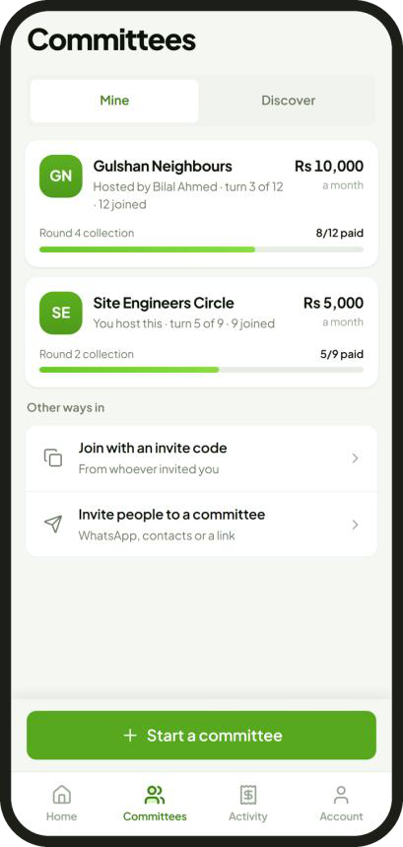
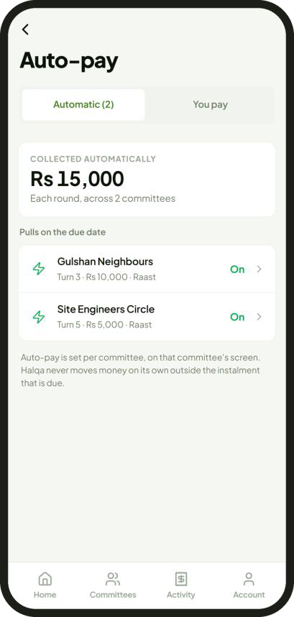
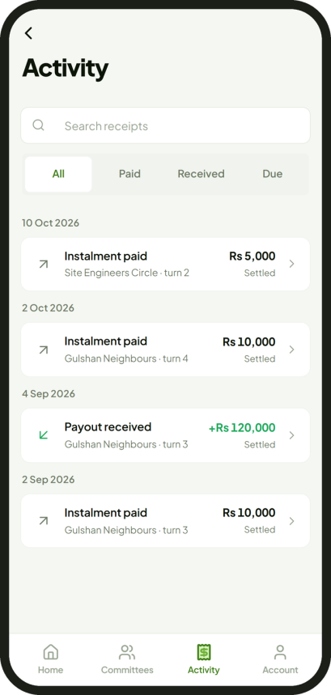
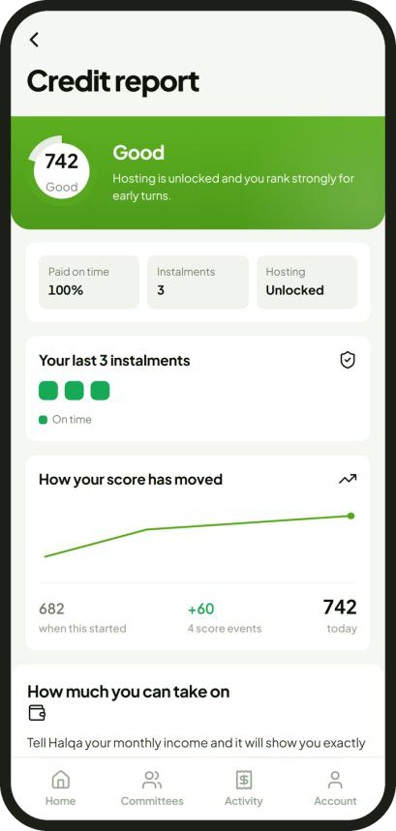
The Product
Members do everything in the Halqa application. Under the partnership, the Raqami account opens inside it.
1 Join a circle
2 Pay automatically
3 Collect the pot
4 Build a credit record
Only circles and turns the member qualifies for
Debited by Raqami on the due date
Paid into the member's own account
Every payment scored and reported
Screens from the Halqa application in preview, with sample data.
7
Notes:
One application for the member: join a circle and pick a turn the member qualifies for, authorise the debit once, receive the pot in the member's own account, and build a credit record. Under the partnership, Raqami's account opening runs inside the application. The screens are the current preview with sample data.

Slide 8
A Month Inside Raqami
Each step runs on a Raqami product. Automatic debit is the one new piece.
Due date, the 8th
instalment waiting and earning profit
retries
day
1
5
8
10
15
20
25
30
Payday
Waiting
Due date
Missed debit
Circle ends
Salary arrives in the member's Raqami account.
The instalment earns a share of profit for seven days.
Every member is debited; the pot is paid the same day.
One retry each morning, five at most. Penalties go to charity.
Members' profit returns as points.
Raqami current account
7 day term deposit, on mudarabah
Automatic debit, new; free Raqami transfers
Saving Pots
Cash earners. Free cash deposits at over 700 Askari Bank branches. New lines. Takaful for committees; Islamic financing for asset circles.
Raqami product pages and FAQ, read 29 September 2026. The due date of the 8th is proposed; the 7 day term fits where payday is at least seven days before it.
8
Notes:
Salary arrives, the instalment is placed in Raqami's 7 day term deposit and earns a share of profit, and Raqami debits it on the due date and pays the pot the same day. Members paid in cash can deposit it free at Askari Bank branches. When the circle ends, profit returns to members as points, and Saving Pots can hold what comes next. Automatic debit is the one new product Raqami would add.

Slide 9
Mutual Benefit
100,000 members would add about Rs 2.5 billion of deposits, more than Raqami held at 30 June 2026.
Customer deposits, Rs billion
Raqami's aim or need
What committee members bring
2.5
1 million customers in three years
Accounts opened 6 to 20 at a time
1.58
Women, students, farmers, freelancers
The people who already save this way
Only Shariah compliant products
No interest by design
0.25
Financing of Rs 27.6 million so far
A repayment record for every member
Raqami
30 June 2026
10,000
members
100,000
members
Free cash deposits at Askari Bank
Cash earners pay in cash
Assumes Rs 25,000 average balance a member; 1,000,000 members would hold about Rs 25 billion.
Sources Raqami Islamic Digital Bank, half year report to 30 June 2026: deposits Rs 1,581 million, 114,452 accounts, Islamic financing Rs 27.6 million; press reports of Raqami's plans, 2026
9
Notes:
On stated assumptions, 100,000 members bring about Rs 2.5 billion of deposits, more than the Rs 1.58 billion Raqami held at 30 June 2026, and nearly double its 114,452 accounts. Each circle opens 6 to 20 accounts at once. The assumption of Rs 25,000 average balance should be replaced by Raqami's own figures.

Slide 10
Onboarding and Checks
Raqami checks the customer. Halqa checks whether the member can carry the committee.
Member
Sign up
Sees only the circles and turns open to this member
phone number, one time code, PIN
Raqami
Account
CNIC, NADRA biometric check, due diligence
Halqa
Identity
Income
Affordability
Credit score
CNIC and account names match; live face check
salary or daily income arrives regularly
all instalments within a third of income
300 to 850; decides which turns open
Checks rise with risk. Known circles: identity only. Strangers: income, affordability and a credit report as well. Hyper: proof of daily income too.
Stored. Results only; never face images, card numbers or passwords.
10
Notes:
Raqami opens the account with its own checks: CNIC and mobile number, NADRA biometric and due diligence. Halqa then checks identity, income and affordability and computes a credit score from 300 to 850. The member sees only the circles and turns open to them. Halqa stores results only.

Slide 11
Committee Types
The less members know each other, the more checks apply.
Known
Strangers
Large, strangers
Asset
Hyper
Who
family, colleagues, neighbours
matched by Halqa
traders and larger savers
buying a motorcycle or machine
daily earners: drivers, riders, traders
Members
6 to 12
12
20
12
390 to 400
Instalment
Rs 2,000 to 10,000
Rs 10,000
Rs 25,000
Rs 10,000
Rs 450 to 500 a day
Frequency
monthly or weekly
monthly
monthly
monthly
daily
Income checked
Automatic debit
Takaful
Credit report read
Stage
pilot
after the pilot
after the pilot
after the pilot
experimental
required
not required
Turn bands apply in every type. Cover and financing follow the bank's choice of product.
11
Notes:
Known circles are family, colleagues or neighbours; checks are light and there is no takaful. Circles of strangers, large circles and asset circles carry full checks, automatic debit and takaful. Hyper is a daily circle for daily earners, labelled experimental. Raqami serves residents only, so circles with members abroad are left out. The pilot uses known circles only.

Slide 12
Where the Risk Sits
Only an early collector can leave others short. Early turns need strong credit scores.
Still owed after collecting, by turn, Rs thousand: twelve members at Rs 10,000
Turn bands. The credit score decides which turns a member may claim.
110
100
90
80
70
New members. The last three turns only, until two clean circles.
60
50
40
30
Affordability. All instalments within a third of verified income; 40% with other loans.
20
10
0
1
2
3
4
5
6
7
8
9
10
11
12
Commitments. A signed undertaking and mutual guarantee; 24 hours to withdraw.
credit score 650 and above
550 and above
any score; every new member
State Bank of Pakistan, Prudential Regulations for Consumer Financing, R-3, as amended by BPRD Circular Letter 29 of 2021: the 40% limit on loan repayments.
12
Notes:
The only real risk in a committee is a member who collects early and then stops paying. The member at turn 1 of 12 still owes Rs 110,000; the member at turn 12 owes nothing. Early turns are reserved for credit scores of 650 and above, and every new member starts in the last three turns.

Slide 13
Missed Payments and Recovery
Every missed payment has a set response, written into the member's signed undertaking.
Any missed payment
Reminder
Retries
2% penalty
5% penalty
10% penalty
Set off
the evening before
five mornings at most
score falls 10
score falls 20
score falls 40
from the member's own pot
A member who collected, then stopped paying
Contact
Restrict
Takaful pays
Guarantee
Civil suit
hardship plan and a new date
account restricted; score falls 200
members left short are paid in full
the whole balance falls due
on the signed undertaking
Rs 110,000
the most one member can owe after collecting
Never
calls to relatives, contact lists or public names
Charity
receives every late penalty
Contract Act 1872, s.74: a penalty may not exceed reasonable compensation. Code of Civil Procedure, Order XXXVII: summary suits only on cheques and similar instruments.
13
Notes:
Any missed payment gets a reminder, up to five retries, then penalties of 2, 5 and 10 per cent, all paid to charity, with falls in the credit score. A member who has not collected cannot cause a loss. For a member who collected and then stopped: contact and a hardship plan, restriction, takaful pays the others, then the guarantee and a civil suit.

Slide 14
Takaful for Defaults
If an early collector stops paying, takaful pays the other members in full.
Each pot stays Rs 120,000 when the member at turn 1 stops paying
How it works. Each instalment carries a small takaful contribution. The fund pays members left short, in their own names.
Operator. Raqami's takaful partner EFU, or another operator. None contracted for committees.
Price. About 5.5% of the instalment on circles of strangers, priced for a stress case.
Known circles. No takaful needed.
1
2
3
4
5
6
7
8
9
10
11
12
Turn
paid by the other members, Rs 110,000
paid by takaful, Rs 10,000
turn 1: collected, then stopped paying
Takaful pricing model, September 2026: stress case of one circle in five losing a fifth of its members from the earliest turns. EFU and Raqami partnership, November 2025.
14
Notes:
If the member at turn 1 stops paying, each later pot would be Rs 10,000 short. Takaful pays that shortfall, so every other member still receives Rs 120,000. The contribution is about 5.5 per cent of the instalment on circles between strangers, set on a stress case. Raqami already works with EFU for takaful on its cards.

Slide 15
Shariah Structure
Each part of the committee rests on one contract. None of them carries interest.
Part of the committee
Contract
How it works
Instalments
Qard
Each member lends to the member collecting, without interest, and is repaid by the later instalments. Every member takes out exactly what they paid in.
Service fee
Ujrah
A flat fee for running the committee, the same for every turn, never linked to how early the pot is taken.
Waiting balance
Mudarabah
The instalment sits in a term deposit until the due date. Profit is shared; the members' share returns as points.
Cover
Takaful
Members contribute to a takaful fund that pays any member left short.
Late payment
Charity
Penalties are paid to charity. Neither Raqami nor Halqa keeps them.
Changing turns
Swap only
Members may swap turns. A turn is never sold for money or points.
Points
Reward
Earned for paying on time and finishing a circle. Never bought with money.
Every part is subject to the ruling of Raqami's Shariah Board.
Structure proposed by Halqa for review. No Shariah board has ruled on it yet.
15
Notes:
Each part of the committee has one contract. Instalments are qard, an interest free loan between members. The fee is ujrah, a flat charge for the service, the same for every turn. Money waiting for the due date sits in a mudarabah term deposit. Cover is takaful. Penalties go to charity. Turns may be swapped but never sold, and points are never bought. Raqami's Shariah Board rules on every part.

Slide 16
Fees and Revenue
One flat service fee (ujrah), the same for every turn. Raqami collects it and shares its income with Halqa.
One instalment on a circle between strangers, Rs
Rs 13 to 35
Rs 547 takaful
running cost of one payment
Rs 11,047
Rs 1.32 million
Rs 10,000 to the member collecting
fixed cost a month at launch
up to Rs 500 fee, collected by Raqami
About 2,600
Members
Their share of profit, as points
active members to cover fixed costs
Raqami
The fee, its share of profit, takaful, financing
Halqa
An agreed share of Raqami's income
Halqa's 25 September model, before Raqami's terms.
Business Model and Unit Costs, 25 September 2026; takaful pricing model, September 2026. The fee rises with the instalment and the number of members.
16
Notes:
On a circle between strangers the member pays Rs 11,047 an instalment: Rs 10,000 to the collector, Rs 547 of takaful contribution and a fee of up to Rs 500. The fee is the same for every turn, so it is a charge for the service and never a price for early money. Raqami collects it and shares income with Halqa.

Slide 17
Competition
Only Halqa with Raqami has an Islamic bank holding the money, one fee for every turn and a credit record.
Halqa with Raqami
JazzCash Committee
Oraan
Informal committee
Who holds the money
Raqami, an Islamic bank
the organiser's wallet
Oraan's own accounts
the organiser
Price of an early turn
one flat fee
not published
up to 21% of the instalment a month [1]
usually none
Payout
automatic, the same day
by hand, by the organiser [2]
11th to 18th
by hand
Members checked
identity, income, score
phone contacts
device data, bureau
people known
Defaults covered
takaful through the bank
not stated
Oraan's balance sheet
organiser's pocket
Credit record
every payment
none
defaulters only
none
A way out
five set routes
none until the end
before payout
organiser's discretion
yes
partly
no
Sources 1 Oraan terms and fee calculator, read 28 September 2026 2 JazzCash application 5.6.7 release note, 23 August 2026 3 Financial Inclusion Insights
17
Notes:
JazzCash launched a committee feature in August 2026, but the pot sits in the organiser's wallet. Oraan charges the first turn up to 21 per cent of the instalment a month, a price for early money. Halqa with Raqami is the only option where an Islamic bank holds the money, every turn pays one flat fee and every payment builds a credit record.

Slide 18
Evidence from Other Markets
Digital committees scaled first in Saudi Arabia and Egypt, each with a regulator or a bank.
2016
2017
2018
2019
2020
2021
2022
2023
2024
2025
2026
Hakbah
500,000+ users
Saudi Arabia
central bank approval
Series A
Money Fellows
8.5 million users
Egypt
profitable
Esusu
US$1.2 billion value
United States
US$1 billion value
The Money Club
about 200,000 users
India
The failures held members' money without a licence, or guaranteed payouts they could not carry.
Sources Launch Base Africa, October 2025; The National, December 2023; CNBC, 11 December 2025; CB Insights; Halqa review of 25 earlier attempts, August 2026
18
Notes:
Hakbah in Saudi Arabia launched after approval from the Saudi central bank and raised a Series A in 2023. Money Fellows in Egypt started inside the central bank's sandbox and became profitable in 2025. Among 25 earlier attempts, every failure held money without a licence or guaranteed payouts it could not carry.

Slide 19
Why Now
Payments in Pakistan went digital. Committee savings did not.
Share of retail payments made digitally, %
69 million
mobile wallet users at the end of 2024 [1]
88%
92%
85%
78%
Aug 2026
JazzCash launched a committee feature; the pot sits in the organiser's wallet [2]
75% by 2028
national target for adults with a financial account, up from 64% in 2023 [3]
1 Jan 2028
the constitutional deadline to end riba in Pakistan [4]
FY2023
FY2024
FY2025
Jan to Mar
2026
Sources 1 State Bank of Pakistan payment systems reviews, FY2025 and Q3 FY2026 2 JazzCash release notes, August 2026 3 National Financial Inclusion Strategy 2024 to 2028 4 Constitution of Pakistan, Article 38(f), 26th Amendment
19
Notes:
Digital payments rose from 78 to 92 per cent of retail payments in three years, and savings have not followed. JazzCash's committee launch shows the category is moving now. The Constitution sets 1 January 2028 to end riba, and a committee is an interest free product by design.

Slide 20
Regulation and Readiness
The application is built. State Bank regulation comes through Raqami's licence.
State Bank of Pakistan
Built
Application and decision engines live since 20 July 2026; closed to the public; payments in a test environment.
Raqami Islamic Digital Bank
Halqa, the bank's service provider
Connection
Seven messages through Raqami's open platform, from account opening to the daily statement.
Rules, checks, application and records, under the State Bank's outsourcing framework.
Shariah
Each part set out for Raqami's Shariah Board before launch.
To do
Incorporation, the agreement and the Raqami connection.
Halqa takes no licence of its own and never holds member money.
State Bank of Pakistan, Framework for Risk Management in Outsourcing Arrangements by Financial Institutions, 2017, revised 2019.
20
Notes:
The application and its decision engines have run live since 20 July 2026, closed to the public, with payments in a test environment. Halqa becomes Raqami's service provider under the State Bank's outsourcing framework, and connects through Raqami's open platform. Still to do: incorporation, the agreement and the connection.

Slide 21
Pilot
One live month with about 1,000 members, after eight weeks of agreement, approvals and connection.
Week
1
2
3
4
5
6
7
8
9
10
11
12
13
14
Agreement
Approvals
Connection and tests
Live month
Review
Scale decision
Scope
Measured
Then
Up to 100 known circles, about 1,000 members, all with Raqami accounts.
Accounts, balances, on time debits, same day payouts, circles per host, complaints, cost per member.
Circles of strangers, asset circles, then Hyper.
21
Notes:
About eight weeks for the agreement, the Shariah Board ruling, approvals and connection, then one live month with up to 100 known circles and about 1,000 members, then a review and a decision to scale.

Slide 22
Requests
Seven decisions to start.
1
Approve the partnership, with Halqa as service provider under the outsourcing framework.
5
Place instalments in the 7 day term deposit; return profit as points.
2
Take the committee structure to the Shariah Board for a ruling.
6
Arrange takaful cover and the credit reporting route.
3
Take the product to the State Bank for approval or notice.
7
Agree the income share and a one month pilot.
4
Open accounts and automatic debits inside the Halqa application.
22
Notes:
The first three decisions are approvals: the partnership, the Shariah Board ruling and the State Bank route. The next two are products: accounts and automatic debits inside the application, and the term deposit for waiting instalments. The last two are commercial: takaful and credit reporting, and the income share with a one month pilot.

Slide 23
Raqami Islamic Digital Bank
Halqa is the system.
The bank is the machine.
Committees run by Halqa, on Raqami accounts.
Taha Amjed, Chairman, Halqa
A detailed reference on the law, the product, the economics and the evidence is available.
Notes:
Halqa is the system; the bank is the machine. Committees run by Halqa, on Raqami accounts, under Raqami's licence and its Shariah Board.

Slide 24
Appendix
Reference pages for questions.
A1
Risks and controls
A2
Integration
A3
Points and turn swaps
A4
Hyper: daily circles
A5
Leaving a circle
A6
Unit costs
24
Notes:
Reference pages for questions on risk, integration, points and turn swaps, Hyper, leaving a circle and unit costs.

Slide 25
Risks and Controls
Each risk Raqami would carry has a stated control.
Credit
Turn bands on every turn; affordability limits; arrears set off from the late member's own pot; takaful for circles of strangers; no daily circle opens once losses would exceed cover.
Fraud and money laundering
Raqami's due diligence at account opening; payouts only to accounts in the member's own name; fixed amounts on a fixed schedule; review of turn swaps.
Technology and outsourcing
An agreement under the State Bank's outsourcing framework; security testing; audit logs on both sides; inspection rights for Raqami and the State Bank.
Conduct
Instalments within a third of income; the full cost shown before joining; 24 hours to withdraw; recovery by stated steps, never by harassment.
Shariah
Every part ruled on by the Shariah Board before launch; penalties to charity; turns swapped, never sold; points never bought with money.
Reputation
New members start in the last turns; published rules for every circle; Hyper labelled experimental; no public list of defaulters.
25
Notes:
Each risk Raqami would carry, with the control that answers it.

Slide 26
Integration
Halqa sends instructions. Raqami moves the money and confirms every step.
Member
Halqa platform
Raqami systems
Messages. Signed and encrypted, with audit logs on both sides.
1 opens an account in the application
Credentials. Halqa stores no card number, password, banking credential or face image.
2 account and mandate references
3 collection file on the due date
Access. Least privilege for staff and systems; penetration tests every year.
4 signed confirmation of each debit
Data. Hosted where Raqami and the State Bank require; the database moves to Pakistan if asked.
5 receipt; ledger and schedule updated
6 payout instruction: the pot, less arrears
Agreement. Service levels, audit and inspection rights, complaints, continuity and exit.
7 statement each morning to reconcile
Back up. Card, wallet or Raast through Safepay, a licensed payment service provider, for money coming from other banks.
Interfaces proposed, not agreed. Governed by the State Bank's outsourcing framework.
26
Notes:
Seven messages connect Halqa and Raqami. Halqa sends instructions; Raqami executes and confirms; Halqa reconciles its ledger against Raqami's statement every morning. No money passes through Halqa.

Slide 27
Points and Turn Swaps
Points are earned, never bought. Turns may be swapped, never sold.
Points
Turn swaps
Paid on time
60 points
Five on time in a row
100 more
Ask
Match
Check
Approve
Swap
Hosting a clean circle
2,500
a member asks to swap
a willing member
both bands allow it
the host agrees
turns change; no money
Referral who completes a circle
1,000
Share of profit on balances
1 point a rupee
Where. Monthly circles only; never on Hyper or asset circles.
Spent on
goods and fees
Price. None. A turn is never sold for money or points.
Never cashed out and never sold. The rupee value of earned points is set before launch, subject to the Shariah Board.
Checks. Both members re-checked for their new turns before the swap.
Record. Every swap is recorded on the circle's ledger.
Seat exchange and points design, 25 September 2026, restricted here to what an Islamic bank can offer.
27
Notes:
For an Islamic bank the points and turn features are restricted: points are earned and never bought, and turns may be swapped but never sold. Both stay subject to the Shariah Board.

Slide 28
Hyper: Daily Circles
For members with daily income. Labelled experimental, with a hard stop on losses.
Option 1
Option 2
Who. Drivers, riders and traders paid daily, often through employers and associations as hosts.
Members
400
390
Days
50
26, Sundays off
Cash. Members paid in cash deposit it free at over 700 Askari Bank branches.
Members collecting each day
8
15
Paid each day
Rs 450
Rs 500
Entry. Rs 1,000 or more received on five days a week for eight weeks; two clean circles; one Hyper circle at a time.
to the pot
Rs 300
Rs 333.33
to takaful
Rs 75
Rs 83.33
Always. Automatic debit and takaful for every member; one flat fee, never graded by the day of collection.
fee
Rs 75
Rs 83.33
Pot, collected once
Rs 15,000
Rs 8,666.67
Hard stop. No new day opens once unrecovered losses would exceed the takaful cover. Penalties go to charity.
Paid over the cycle
Rs 22,500
Rs 13,000
Two options fixed on 23 September 2026. Pot = daily contribution x days; roster = collectors a day x days.
28
Notes:
Hyper is a daily circle for people paid daily. Option 1: 400 members over 50 days, eight collecting each day, Rs 450 a day. Option 2: 390 members over 26 days, fifteen collecting each day, Rs 500 a day. Members paid in cash can deposit at Askari Bank branches. It is labelled experimental.

Slide 29
Leaving a Circle
There is no cancel button. A member who has not collected leaves by one of five set routes.
Window
Substitute
Group vote
Hardship
Abandon
inside the 24 hours before the start: free, no record
a replacement takes the turn and repays the leaver
72 hour vote; fine of one instalment; money back at the close
recorded statement; fine waived; recorded as hardship
not an exit: the recovery steps apply
Worked example
Rs 40,000
Twelve members at Rs 10,000. One leaves after round 4, having paid Rs 40,000.
The circle continues with eleven, so each later pot is Rs 10,000 smaller.
The four members who already collected full pots each return Rs 10,000 at the close.
returned to the leaver at the end of the circle, less any fine, with no profit. The wait is the deterrent.
Fines go to charity; neither Raqami nor Halqa keeps them.
29
Notes:
There is no cancel button. Inside the 24 hour window a member leaves freely. After that the preferred route is a substitute who takes the turn. A group vote allows exit with a fine of one instalment, paid to charity; hardship waives the fine. Money comes back at the end of the circle, without profit.

Slide 30
Unit Costs
The costs Halqa carries, and what the bank route changes.
Prices used
What the bank route changes
WhatsApp message
Rs 4.35
Before
With Raqami
Identity check, NADRA
Rs 50, planning
Member fee
Rs 100 to 500, to Halqa
Collected by Raqami as ujrah
Credit report
Rs 200, planning
Halqa income
Fees and takaful commission
An agreed share of Raqami's income
Support agent a month
Rs 60,000
Cloud, a member a month
Rs 2
Collection
1%, capped at Rs 10 a debit, through Safepay
A transfer inside one bank, near nil
Acquiring a member
Rs 250, planning
Cover
Takaful, Halqa as agent
Takaful arranged through Raqami
Credit reports
Rs 200 a report
Reported through Raqami, or by Halqa
Business Model and Unit Costs, 25 September 2026, before the bank's terms. Planning figures are marked.
30
Notes:
Prices used in the 25 September model, and how each line changes when Raqami collects the fee and holds the money.

